Slide 1
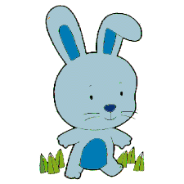
Bunny’s Big Week

Slide 2
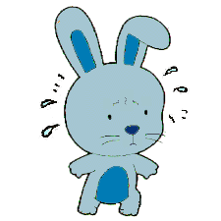
This is Bunny.
Bunny is worried because next week s/he has to give show-and-tell.
Show-and-tell makes bunny worried.

Slide 3
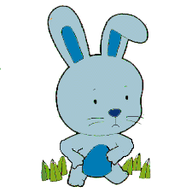

On Monday morning, Bunny thinks about show-and-tell, and so Bunny feels worried. Bunny eats some cheese.
Bunny has a tummy ache.
Notes:
Hmm, I wonder why bunny has a tummy ache, let’s keep reading to find out.

Slide 4
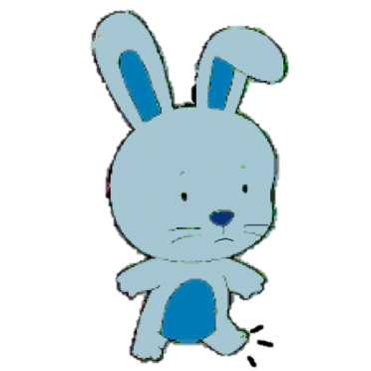

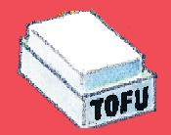
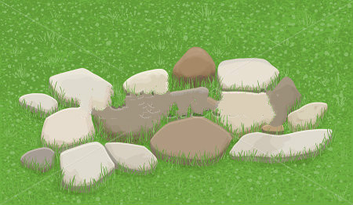
On Monday afternoon, Bunny eats some tofu. Bunny ties her/his shoes very tight. Bunny runs very fast on the hard rocks.
Bunny has sore foot. Bunny doesn’t have a tummy ache.
Notes:
Hmm, I wonder why bunny has a sore foot; let’s keep reading to find out.

Slide 5

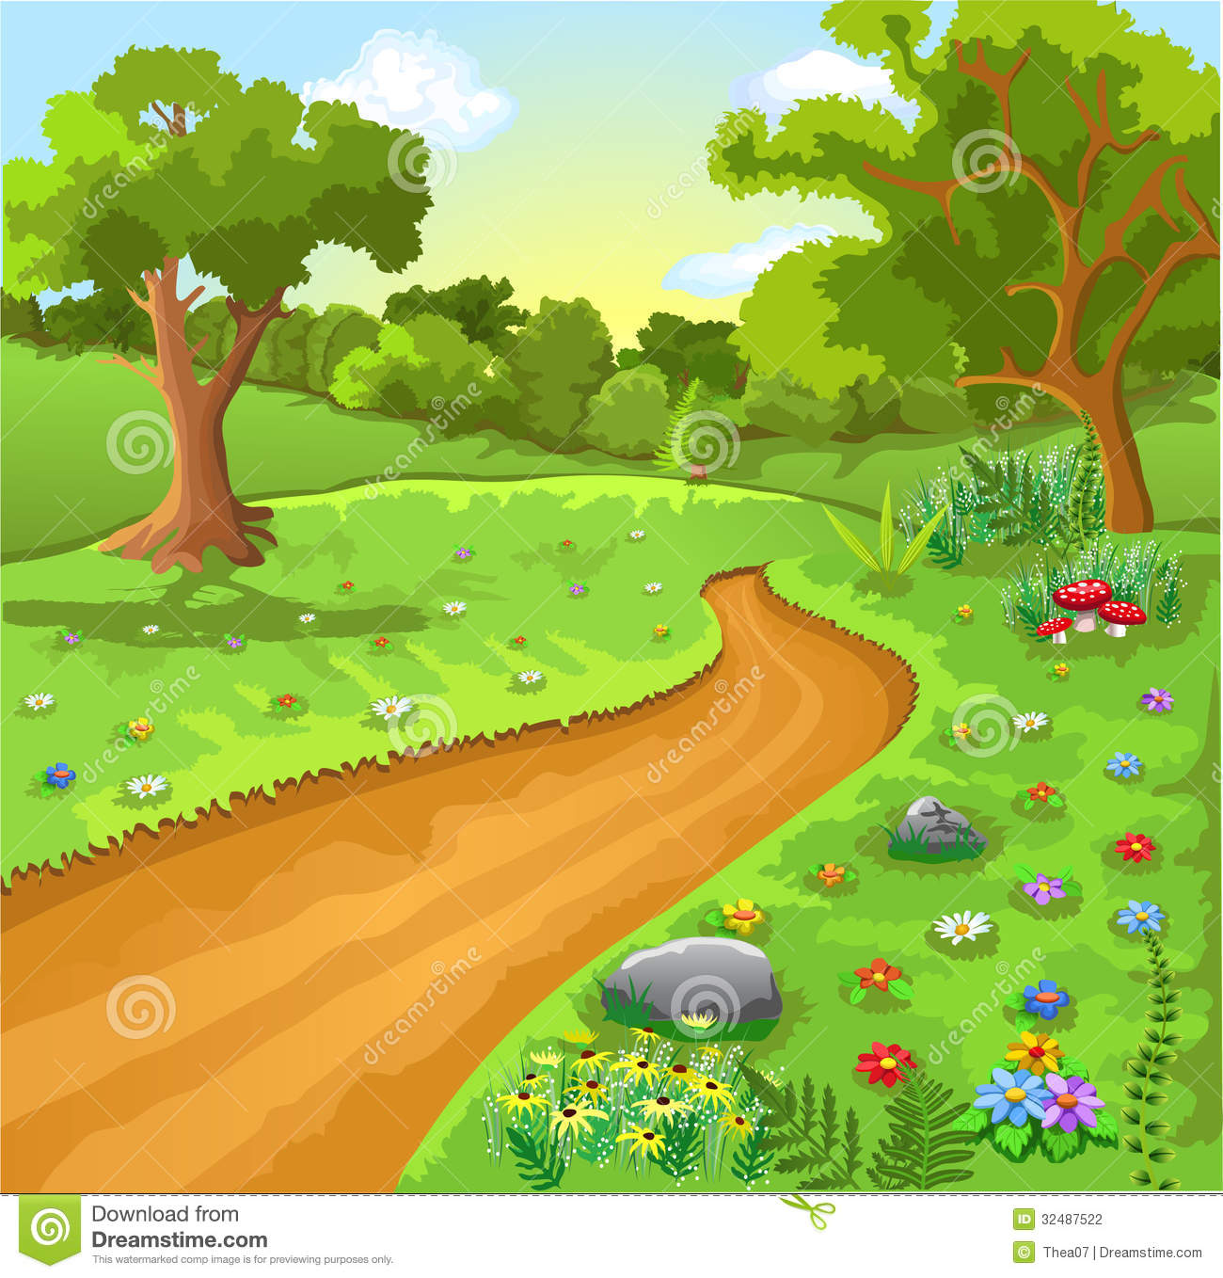
On Tuesday morning, Bunny goes for a walk. Bunny eats a popsicle. Bunny thinks about show-and-tell and so Bunny feels worried.
Bunny has a tummy ache. Bunny doesn’t have sore foot.

Slide 6
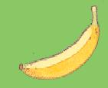
On Tuesday afternoon, Bunny runs very fast on the hard rock. Bunny ties his/her shoes very tight. Bunny eats a banana.
Bunny has sore foot. Bunny doesn’t have a tummy ache.

Slide 7
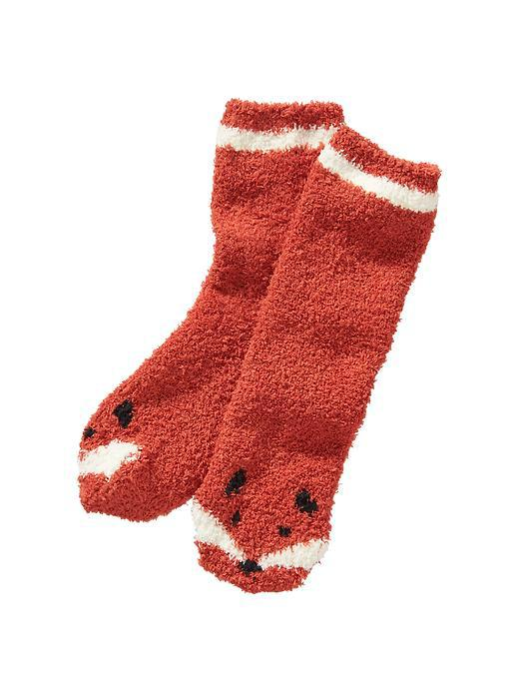
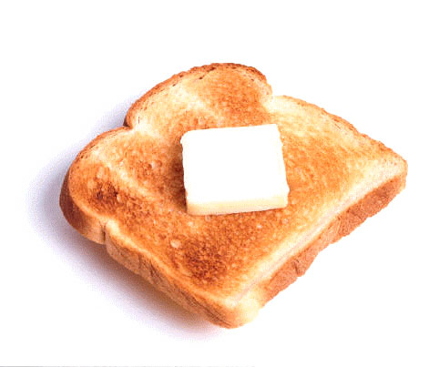
On Wednesday morning, Bunny puts on snug socks. Bunny thinks about show-and-tell and so Bunny feels worried. Bunny eats some toast.
Bunny has a tummy ache. Bunny doesn’t have sore foot.

Slide 8
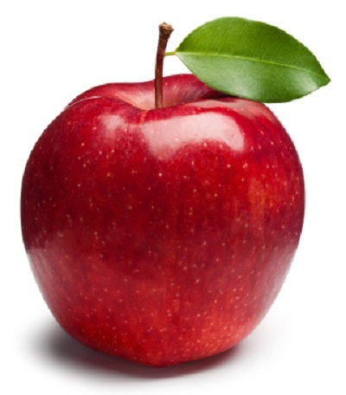
On Wednesday afternoon, Bunny eats an apple. Bunny ties his/her shoes very tight. Bunny runs very fast on the hard rock.
Bunny has sore foot. Bunny doesn’t have a tummy ache.

Slide 9
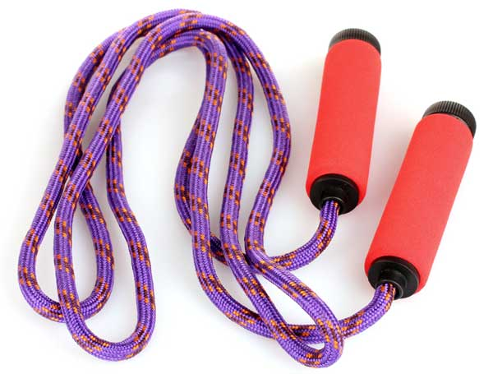
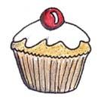
On Thursday morning, Bunny plays jump rope. Bunny eats a muffin. Bunny thinks about show-and-tell and so Bunny feels worried.
Bunny has a tummy ache. Bunny doesn’t have sore foot.

Slide 10
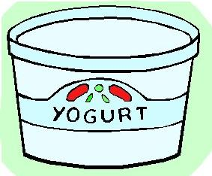
On Thursday afternoon, Bunny runs very fast on the hard rock. Bunny ties his/her shoes very tight. Bunny eats some yogurt.
Bunny has sore foot. Bunny doesn’t have a tummy ache.

Slide 11
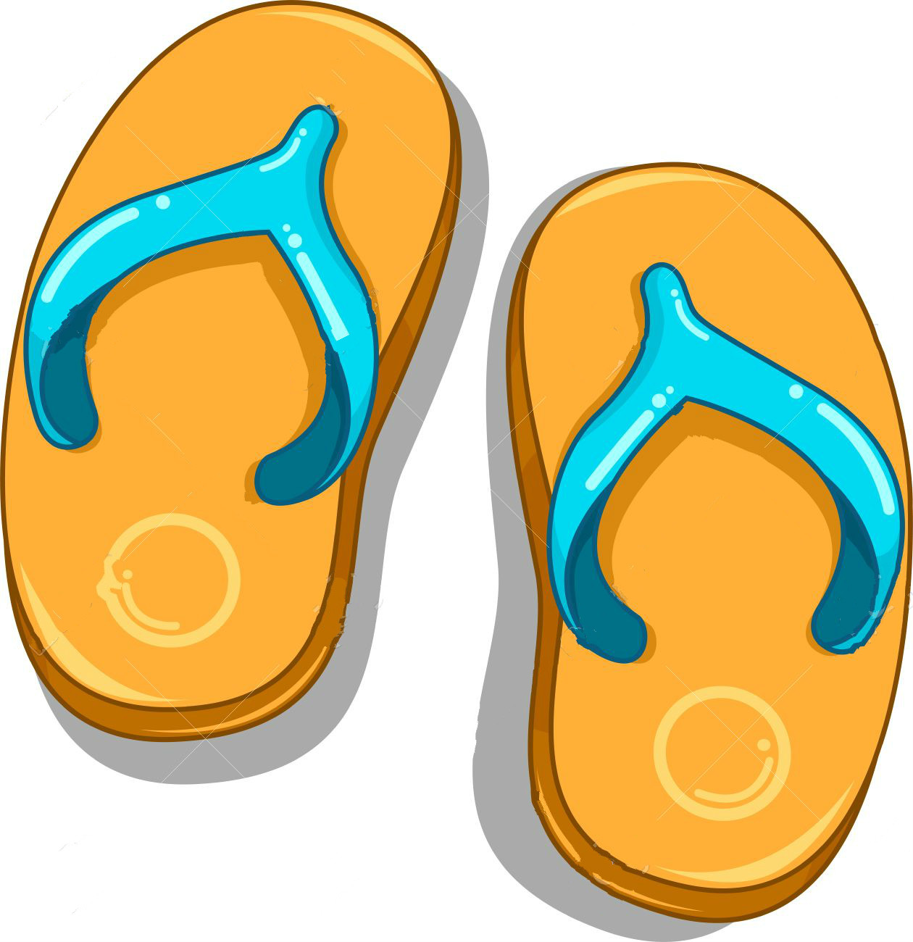
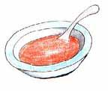
On Friday morning, Bunny wears her/his slippers. Bunny thinks about show-and-tell and so Bunny feels worried. Bunny eats some soup.
Bunny has a tummy ache. Bunny doesn’t have sore foot.

Slide 12
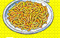
On Friday afternoon, Bunny eats some pasta. Bunny ties his/her shoes very tight. Bunny runs very fast on the hard rock.
Bunny has sore foot. Bunny doesn’t have a tummy ache.

Slide 13
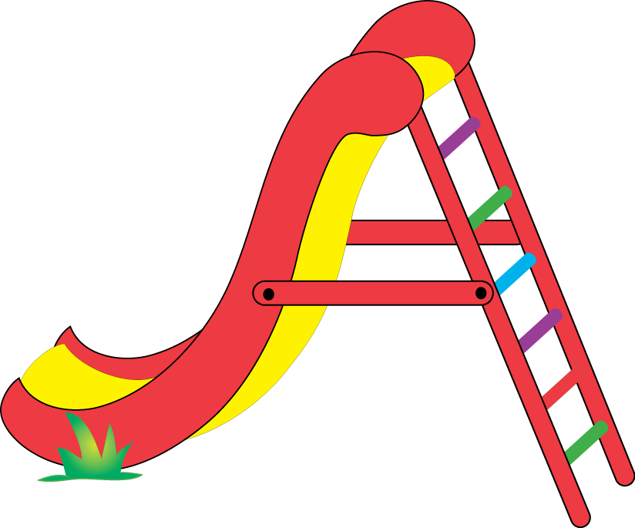

On Saturday morning, Bunny climbs the slide. Bunny eats a carrot. Bunny thinks about show-and-tell and so Bunny feels worried.
Bunny has a tummy ache. Bunny doesn’t have sore foot.

Slide 14

On Saturday afternoon, Bunny runs very fast on the hard rock. Bunny ties his/her shoes very tight. Bunny eats some French fries.
Bunny has sore foot. Bunny doesn’t have a tummy ache.

Slide 15

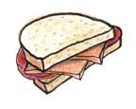
On Sunday morning, Bunny wears his/her rain boots. Bunny thinks about show-and-tell and so Bunny feels worried. Bunny eats a sandwich.
Bunny has a tummy ache. Bunny doesn’t have sore foot.

Slide 16
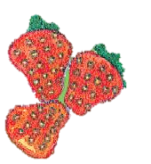
On Sunday afternoon, Bunny eats strawberries. Bunny ties his/her shoes very tight. Bunny runs very fast on the hard rock.
Bunny has sore foot. Bunny doesn’t have a tummy ache.

Slide 17
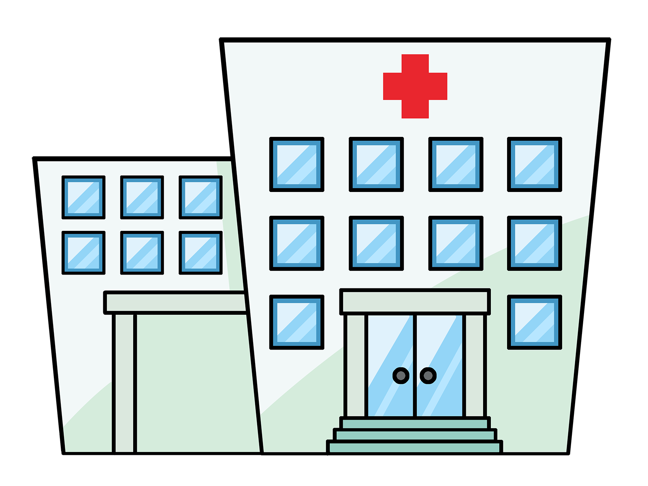

Later in the afternoon, Bunny went to the doctor’s office to find out why s/he has a tummy ache and sore foot.

Slide 18
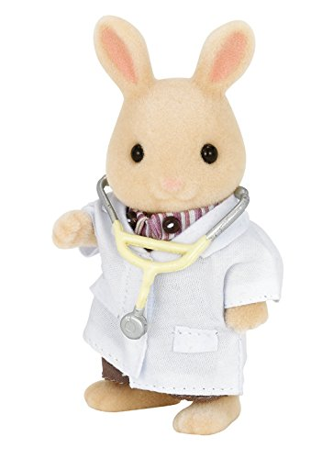
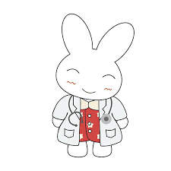


Bunny told the tummy doctor all about her/his week and how on Sunday morning she felt worried and ate a sandwich.
The tummy doctor looked at Bunny’s tummy and says s/he will call Bunny tonight with the reason why Bunny has a tummy ache.
Bunny told the foot doctor all about her/his week and how on Sunday afternoon (s)he tied his/her shoes very tight & ran very fast on the hard rock.
The foot doctor looked at Bunny’s foot and says s/he will send Bunny an email message to tell him/her why s/he has sore foot.

Slide 19

In the evening, Bunny comes home from her doctor’s visits.
(S)he finds that there is an email message from the foot doctor and a phone message from the tummy doctor!
Here’s where we get to have your help with the story!
You can find out why Bunny has a tummy ache from the phone message.
Or, instead, you can find out why Bunny has sore foot from the email message.
If you want to find out why Bunny has tummy ache please click this; if you want to find out why Bunny has sore foot please click that.

Slide 20
Phone message:
Bunny has a tummy ache because she/he was worrying about show-and-tell.
Notes:
Bunny has a tummy ache because she/he was worrying about show-and-tell.

Slide 21
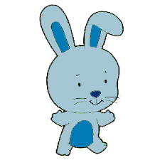
The next Monday, in the morning, Bunny ran on the grass. Bunny also gave show-and-tell. S/he did very well and everyone clapped! Bunny felt great.
The End
Hurray for Bunny!

Slide 22
Email message:
Bunny has sore foot because she/he was running on the hard rock.
Notes:
Bunny has sore foot because she/he was running on the hard rock.

